Slide 1
SPARK
Architecture, RDD’s

Slide 2
What is Spark ?
Apache Spark is a lightning-fast cluster computing technology, designed for fast computation.
Spark is not a modified version of Hadoop
It is based on Hadoop MapReduce and it extends the MapReduce model to efficiently use it for more types of computations, which includes interactive queries and stream processing.
The main feature of Spark is its in-memory cluster computing that increases the processing speed of an application.
Covers wide range of workloads – Streaming – No need of other separate tools.

Slide 3
Why Spark ? - Its all about speed !
The reason is that Hadoop framework is based on a simple programming model (MapReduce)
Here, the main concern is to maintain speed in processing large datasets in terms of waiting time between queries and waiting time to run the program.
Speed − Spark helps to run an application in Hadoop cluster, up to 100 times faster in memory, and 10 times faster when running on disk. This is possible by reducing number of read/write operations to disk. It stores the intermediate processing data in memory.
Supports multiple languages − Spark provides built-in APIs in Java, Scala, or Python. Therefore, you can write applications in different languages.
Advanced Analytics − It supports SQL queries, Streaming data, Machine learning (ML), and Graph algorithms.

Slide 4
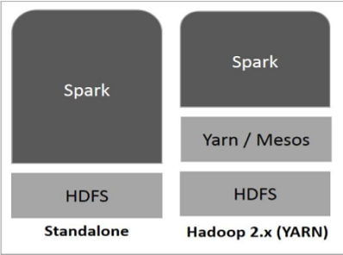
Implementation ? – Not a problem

Slide 5
Hadoop Vs Spark – A war within
Hadoop | Spark
Distributed storage + Distributed Compute | Distributed Compute only
Map Reduce Framework | Generalized Computation
Usually Data on Disk (HDFS) | On Disk/in memory
Not Ideal for iterative work | Great for iterative workloads (Machine learning)
Batch process | -Upto 10X faster for data on disk -Upto 100x faster for data in memory

Slide 6
What Hadoop gives spark ?
YARN resource manager, which takes responsibility for scheduling tasks across available nodes in the cluster;
Distributed File System, which stores data when the cluster runs out of free memory, and which persistently stores historical data when Spark is not running;
Disaster Recovery capabilities, inherent to Hadoop, which enable recovery of data when individual nodes fail. These capabilities include basic (but reliable) data mirroring across the cluster and richer snapshot and mirroring capabilities

Slide 7
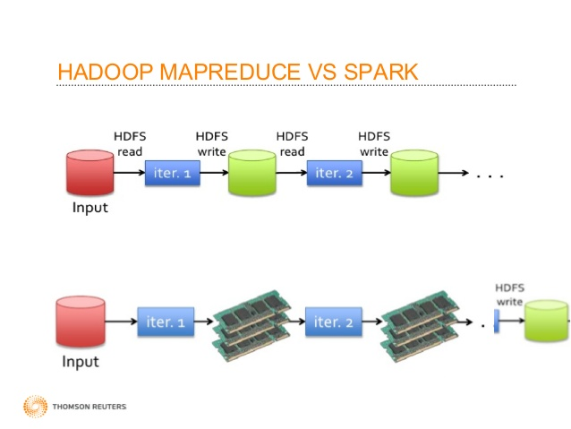
Seeing is believing right ? Here is how they work

Slide 8
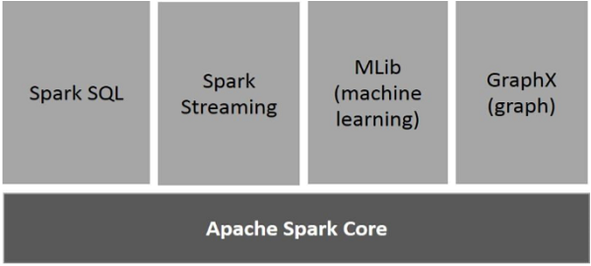
Spark Components

Slide 9
Spark Components
Spark Core is the underlying general execution engine for spark platform that all other functionality is built upon. It provides In-Memory computing and referencing datasets in external storage systems.
Spark SQL is a component on top of Spark Core that introduces a new data abstraction called SchemaRDD, which provides support for structured and semi-structured data.
Spark Streaming leverages Spark Core's fast scheduling capability to perform streaming analytics. It ingests data in mini-batches and performs RDD (Resilient Distributed Datasets) transformations on those mini-batches of data
MLlib is a distributed machine learning framework above Spark because of the distributed memory-based Spark architecture.
GraphX is a distributed graph-processing framework on top of Spark. It provides an API for expressing graph computation

Slide 10
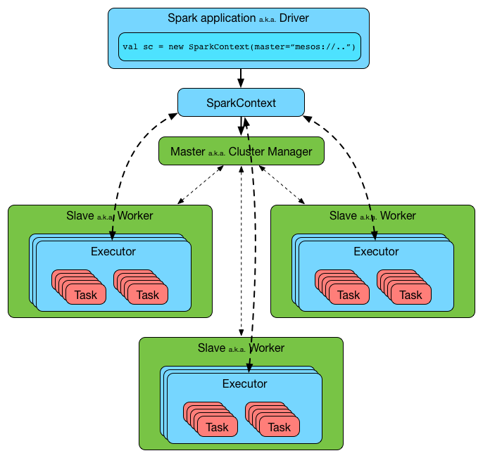
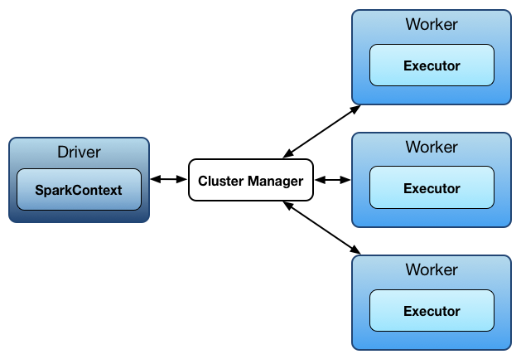
Spark and its Architecture

Slide 11
Spark Architecture – Driver
Spark uses a master/worker architecture. There is a driver that talks to a single coordinator called master that manages workers in which executors run.
A Spark driver (aka an application’s driver process) is a JVM process that hosts SparkContext for a Spark application. It is the master node in a Spark application.
It splits a Spark application into tasks and schedules them to run on executors.
A driver is where the task scheduler lives and spawns tasks across workers.
A driver coordinates workers and overall execution of tasks

Slide 12
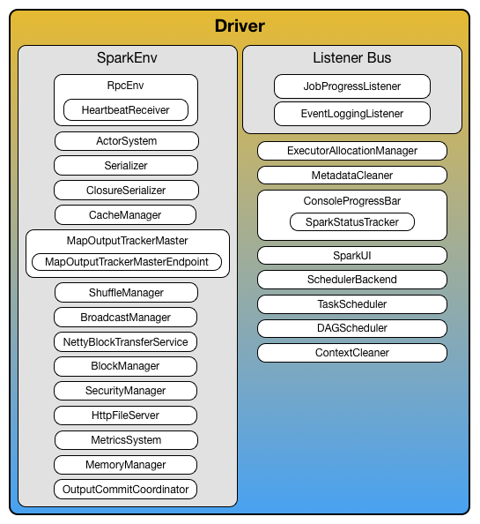
Spark Architecture – Driver

Slide 13
Spark Architecture - Executor
Executor is a distributed agent that is responsible for executing tasks.
Executor typically runs for the entire lifetime of a Spark application which is called static allocation of executors (but you could also opt in for dynamic allocation).
Executors report heartbeat and partial metrics for active tasks to “heart beat receiver” RPC endpoint on the driver
Executors provide in-memory storage for RDDs that are cached in Spark applications
Executors are described by their id, hostname, Environment and classpath

Slide 14
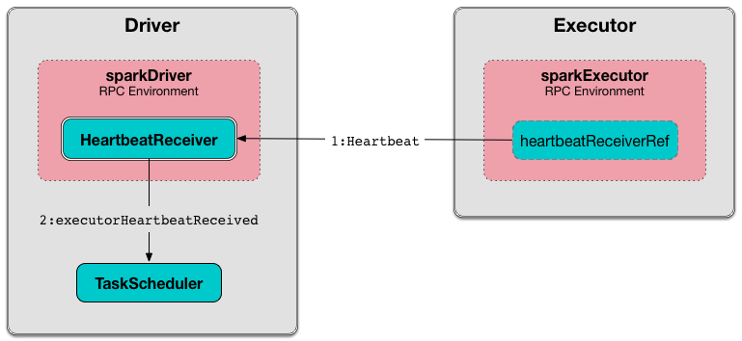
Spark Architecture - Executors

Slide 15
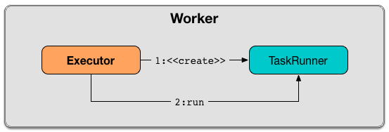
Spark Architecture – Task Runner
Task Runner is a thread of execution that manages a single individual task.
It is created exclusively when executor is requested to launch a task

Slide 16
Spark Architecture – Worker
Workers (aka slaves) are running Spark instances where executors live to execute tasks. They are the compute nodes in Spark.
It hosts a local Block Manager that serves blocks to other workers in a Spark cluster. Workers communicate among themselves using their Block Manager instances.

Slide 17
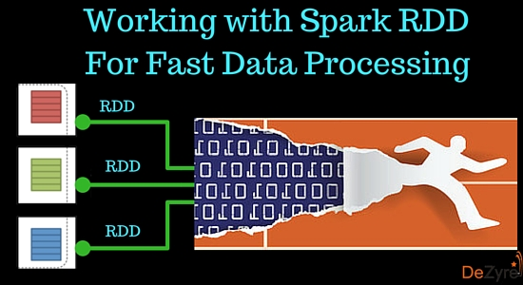
RDD’s
Resilient Distributed Datasets (RDD) is a fundamental data structure of Spark.
It is an immutable distributed collection of objects. Each dataset in RDD is divided into logical partitions and can store in-memory on worker nodes.
Resilient - Meaning it provides fault tolerance through lineage graph. A lineage graph keeps a track of transformations to be executed after an action has been called. RDD lineage graph helps recomputed any missing or damaged partitions because of node failures.
Distributed - RDDs are distributed - meaning the data is present on multiple nodes in a cluster.

Slide 18
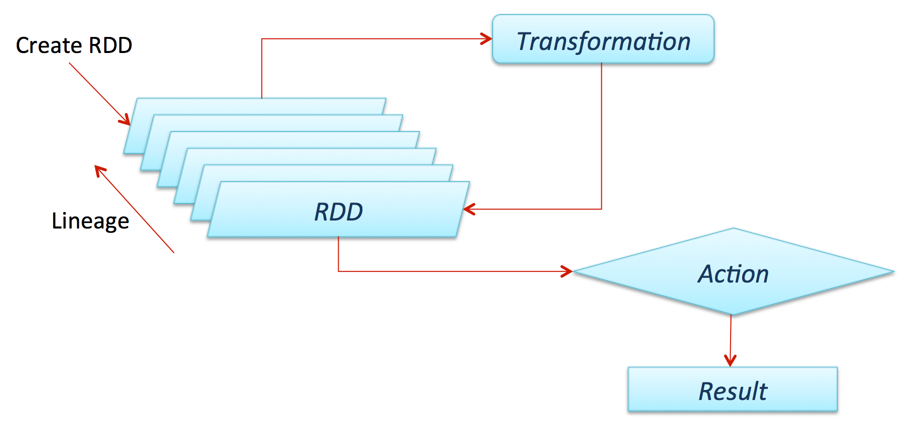
RDD

Slide 19
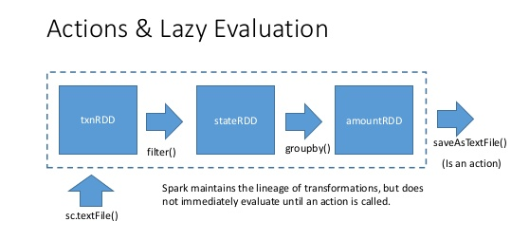
RDD’s – features
Immutable - They read only abstraction and cannot be changed once created. However, one RDD can be transformed into another RDD using transformations like map, filter, join, cogroup, etc. Immutable nature of RDD Spark helps attain consistencies in computations.
Partitioned - RDDs in Spark have collection of records that contain partitions. Partitions in RDDs are the basic units of parallelism.
Lazy Evaluated - RDDs are computed in a lazy manner, so that the transformations can be pipelined. Data inside RDDs will not be transformed unless, an action that triggers the execution of transformations is invoked

Slide 20
RDD’s – features
Persistence - The persistence of RDDs makes them good for fast computations. Users can specify which RDD they want to reuse and select the desired storage for them -whether they would like to store them on disk or in-memory.
Fault Tolerance - Spark RDDs log all transformation in a lineage graph so that whenever a partition is lost, lineage graph can be used to reply the transformation instead of having to replicate data across multiple nodes (like in Hadoop MapReduce).

Slide 21
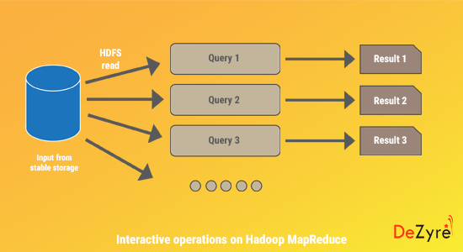
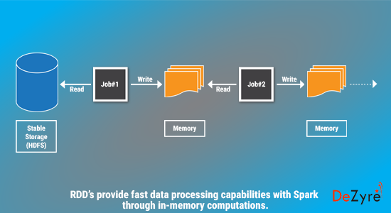
Interactive operations

Slide 22
DAG – Directed Acyclic Graph
Direct - Transformation is an action which transitions data partition state from A to B.
Acyclic -Transformation cannot return to the older partition
DAG is a sequence of computations performed on data where each node is an RDD partition.
The DAG scheduler divides operators into stages of tasks. A stage is comprised of tasks based on partitions of the input data. The DAG scheduler pipelines operators together.
The Stages are passed on to the Task Scheduler. The task scheduler launches tasks
The Worker executes the tasks on the Slave.

Slide 23
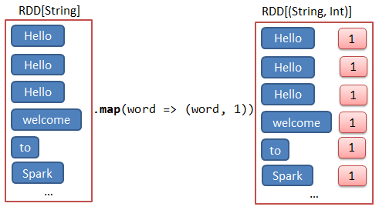
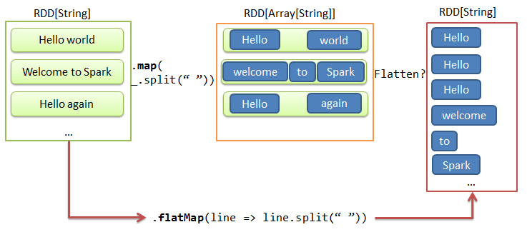
Transformation – A little insight

Slide 24
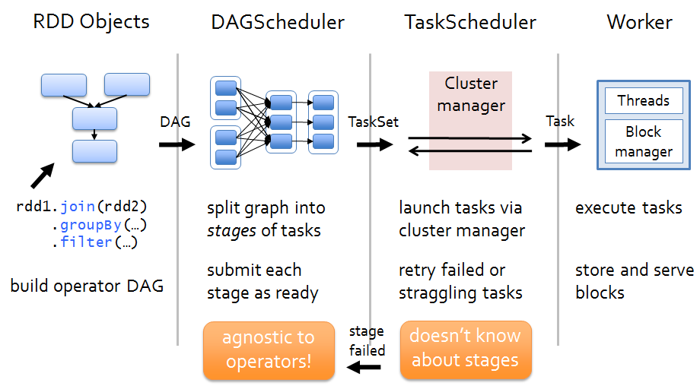
How a program executes ?

Slide 25


